Slide 1
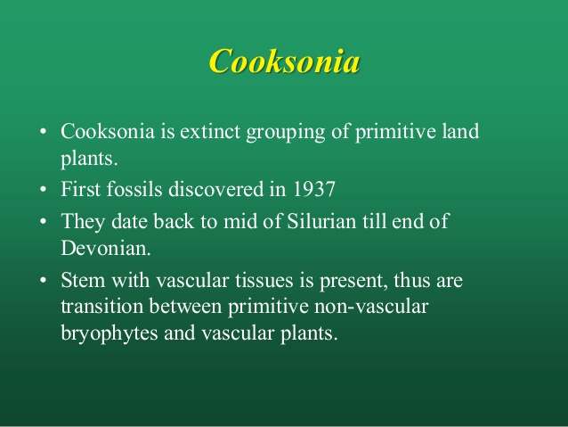

Slide 2
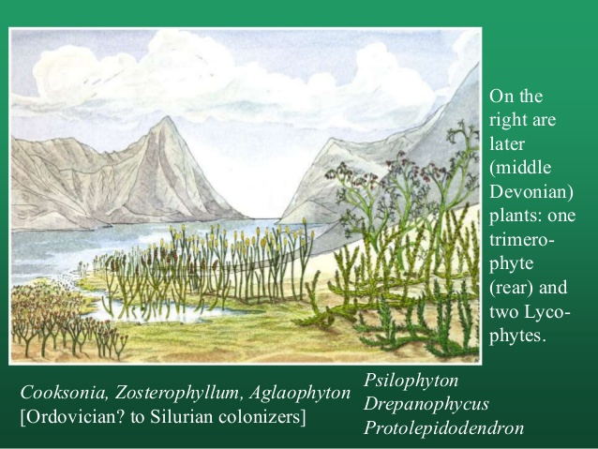

Slide 3
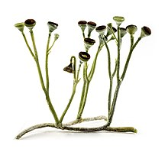
Reconstruction as an independent plant

Slide 4
Physiology
Cooksonia is green and red photosynthesizing self sufficient stem.
It is likely that some fossils preserve a sporophyte generation which was dependent on gametophyte.
However, no fossil record of gametophyte has been discovered to date.
In 2018, the sporophyte of a new specie C. barrandae was described from 432 million years ago.

Slide 5
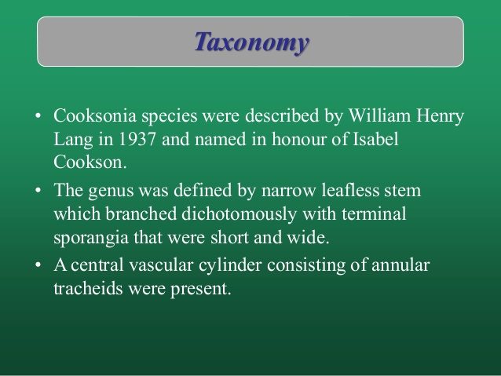

Slide 6
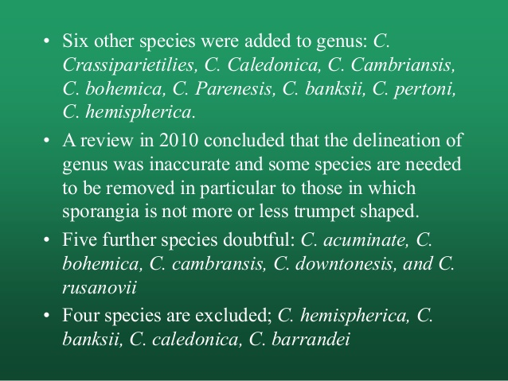

Slide 7
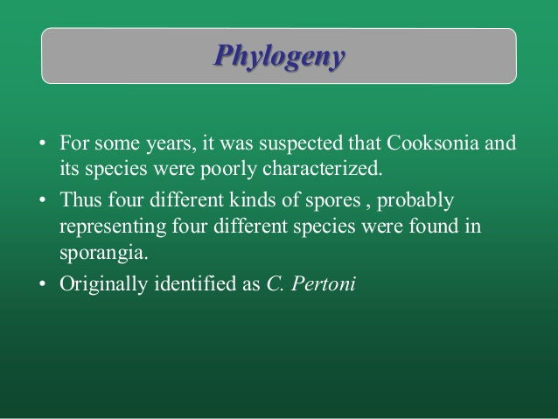

Slide 8
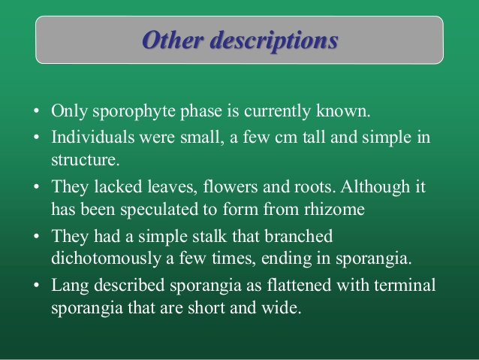

Slide 9
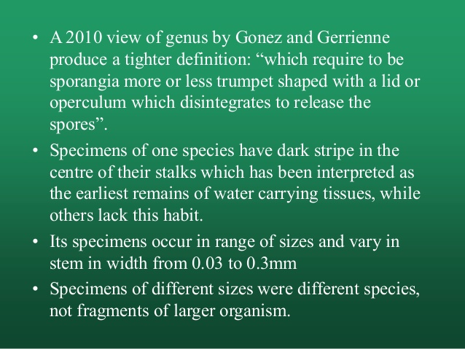

Slide 10
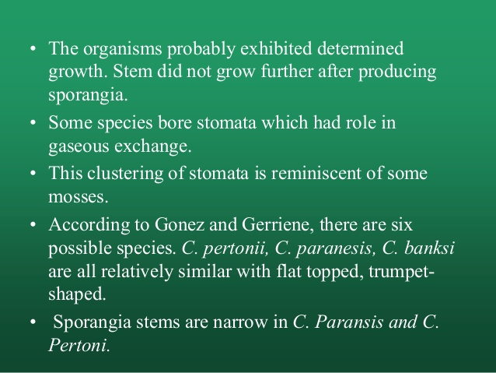

Slide 11
